Slide 1




Build Ontology View on ArchiMate 3.2 Specification
001
Opening

Slide 2

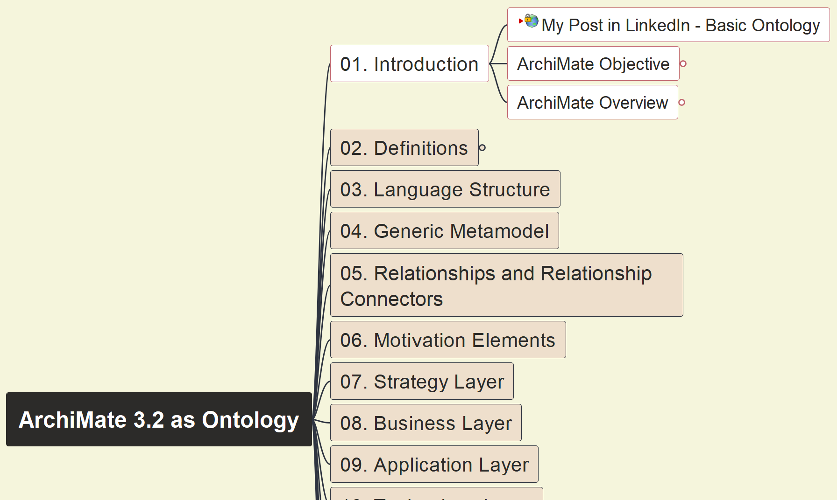
Build Ontology View on ArchiMate 3.2
002
ArchiMate Language Objective

Slide 3
Build Ontology View on ArchiMate 3.2
003
ArchiMate Language Overview

Slide 4
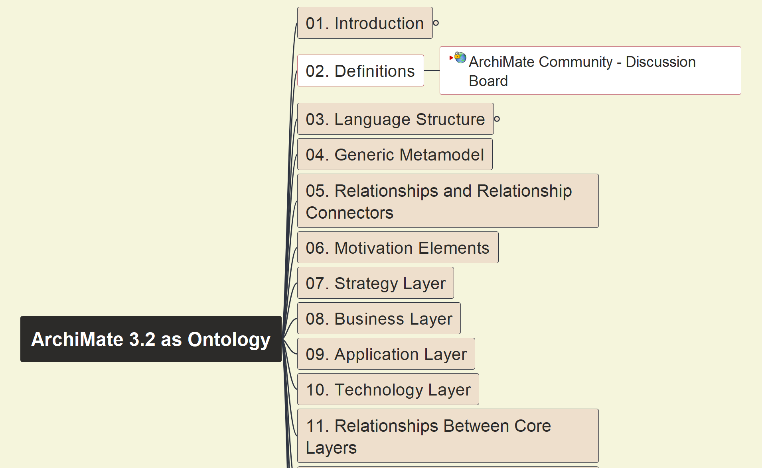
Build Ontology View on ArchiMate 3.2
004
ArchiMate Definition

Slide 5
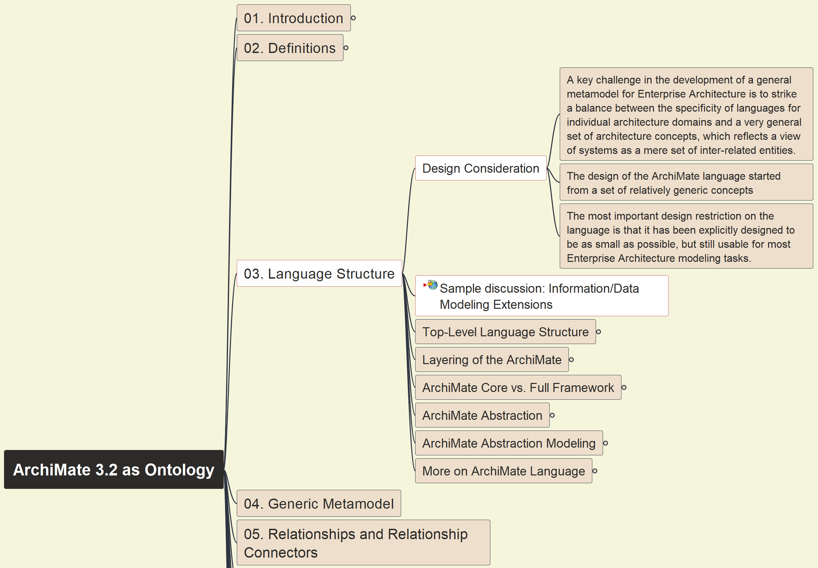
Build Ontology View on ArchiMate 3.2
005
ArchiMate Structure – Design Consideration

Slide 6
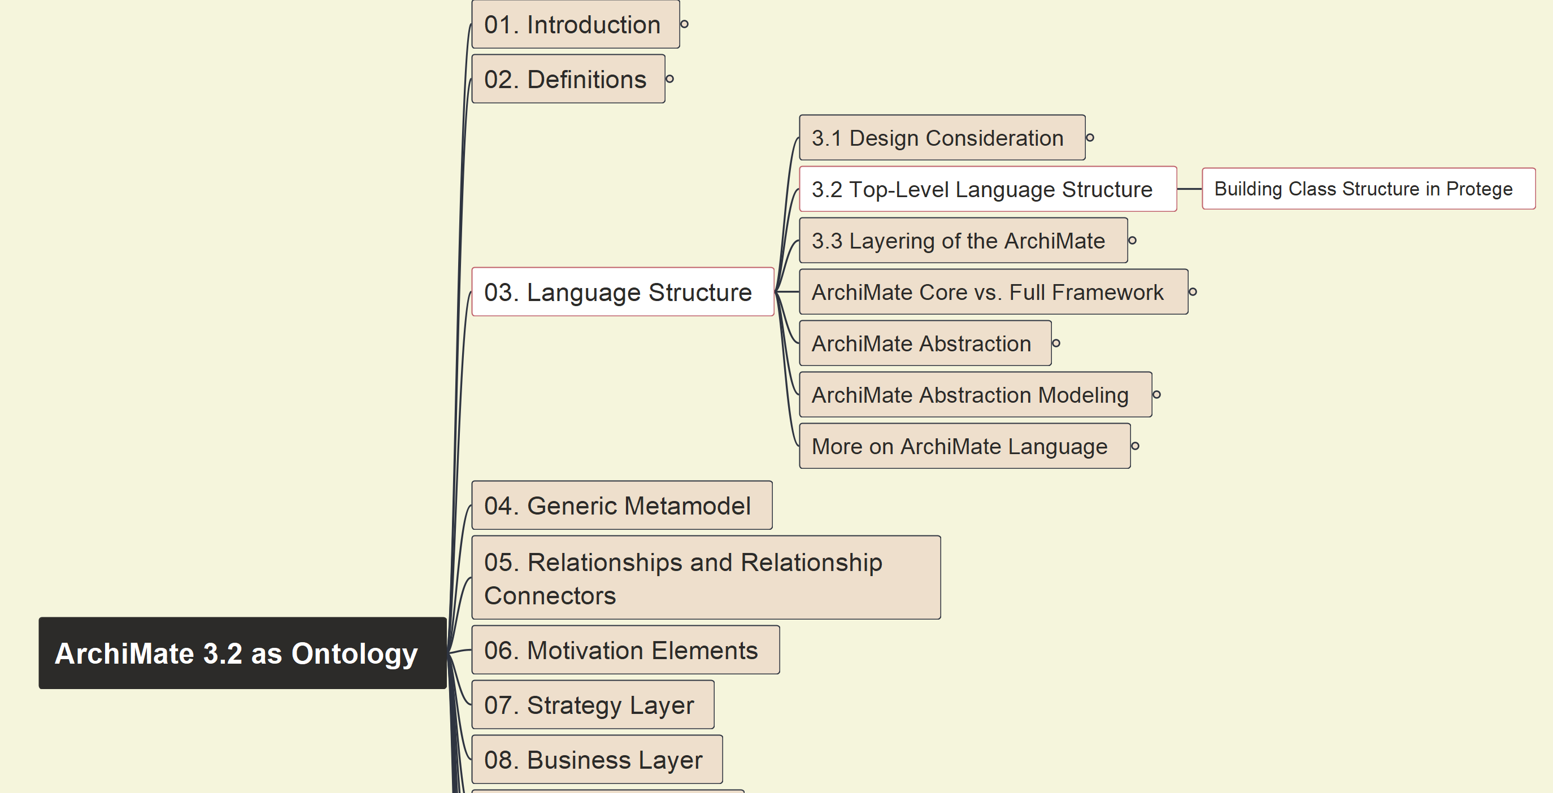
Build Ontology View on ArchiMate 3.2
006
ArchiMate Top-Level Structure

Slide 7
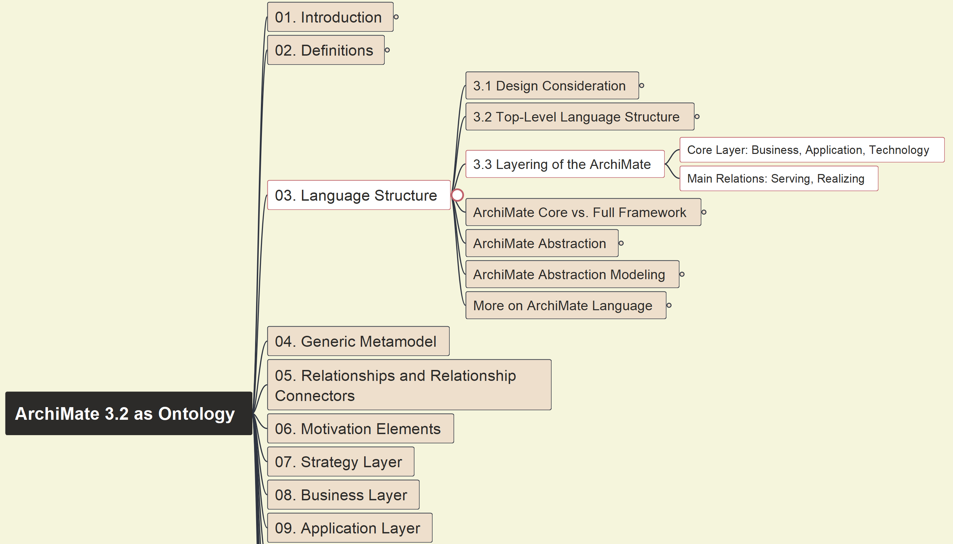
Build Ontology View on ArchiMate 3.2
007
ArchiMate Layering

Slide 8
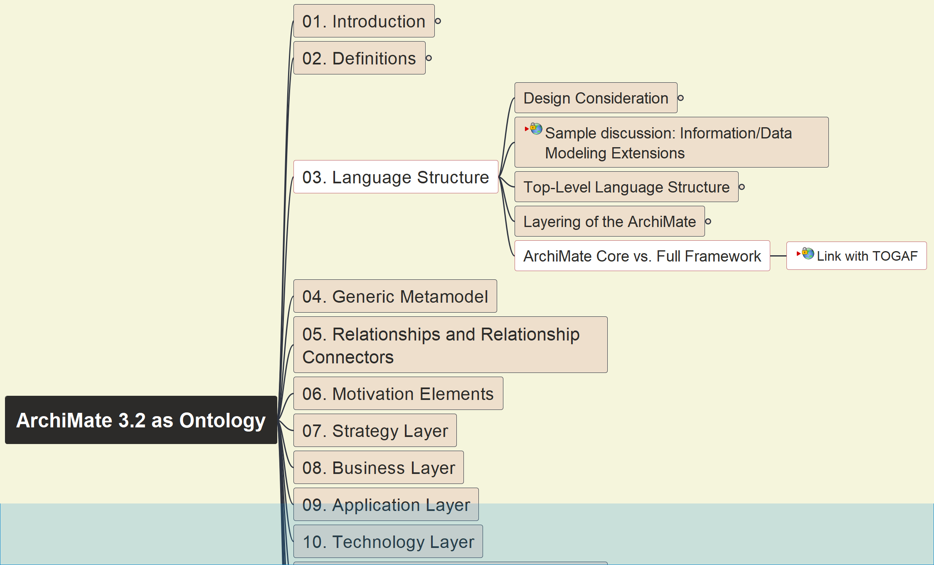
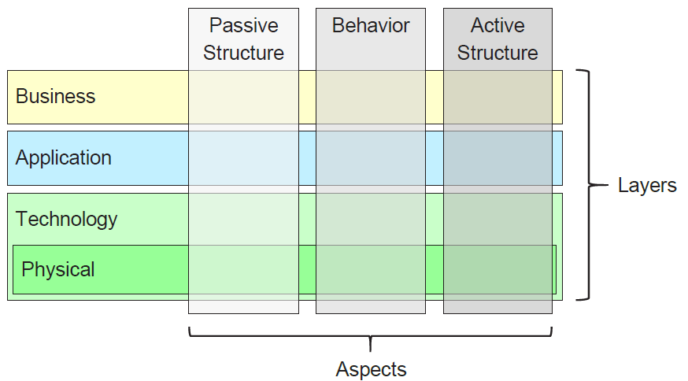
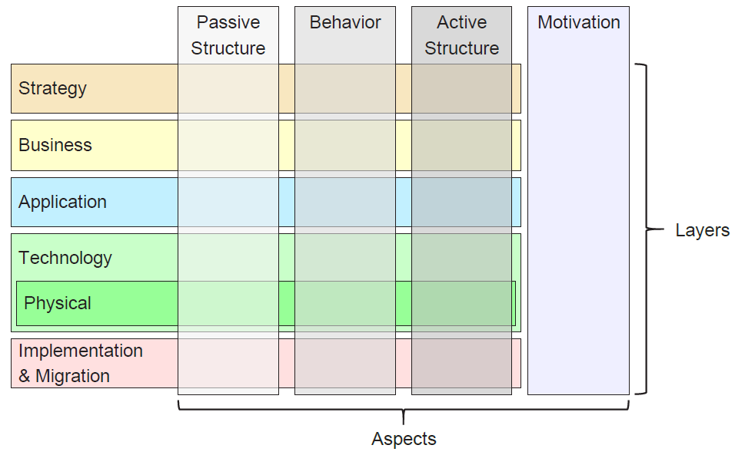
Build Ontology View on ArchiMate 3.2
008
ArchiMate Core vs. Full Framework

Slide 9
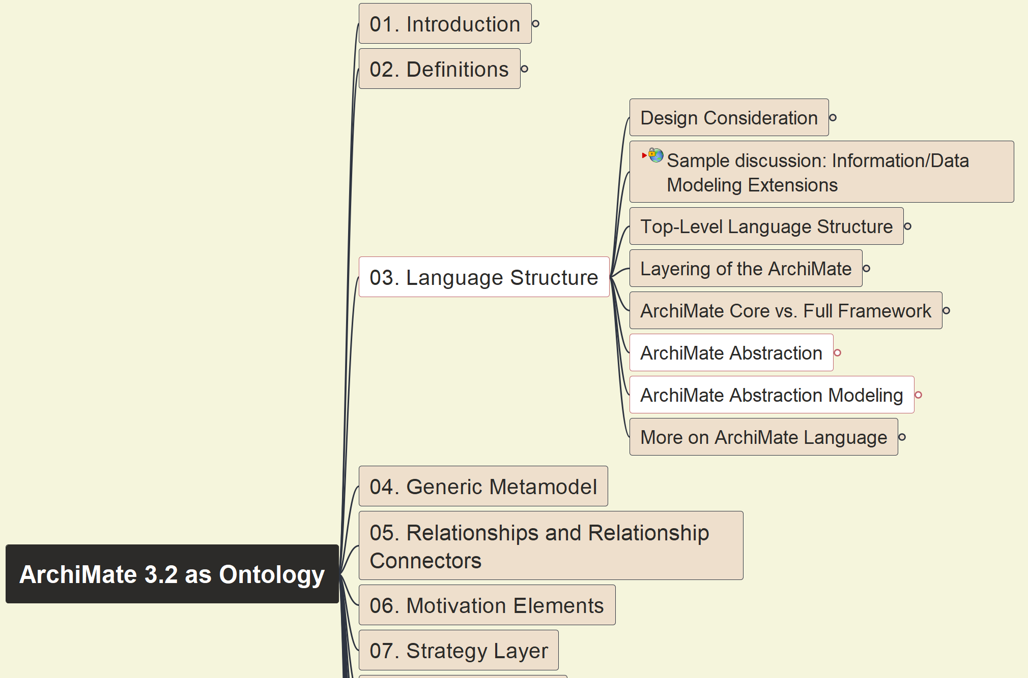
Build Ontology View on ArchiMate 3.2
009
ArchiMate Abstraction and Modeling

Slide 10
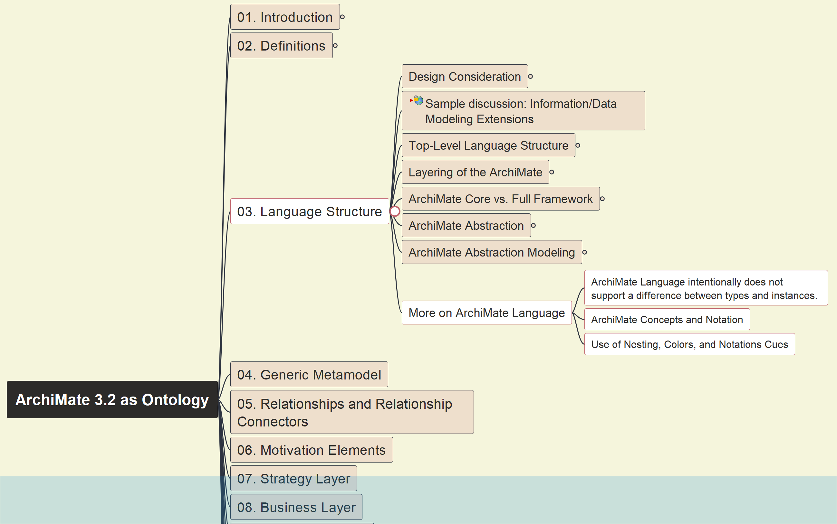
Build Ontology View on ArchiMate 3.2
010
More on ArchiMate Language Structure

Slide 11





